Slide 1
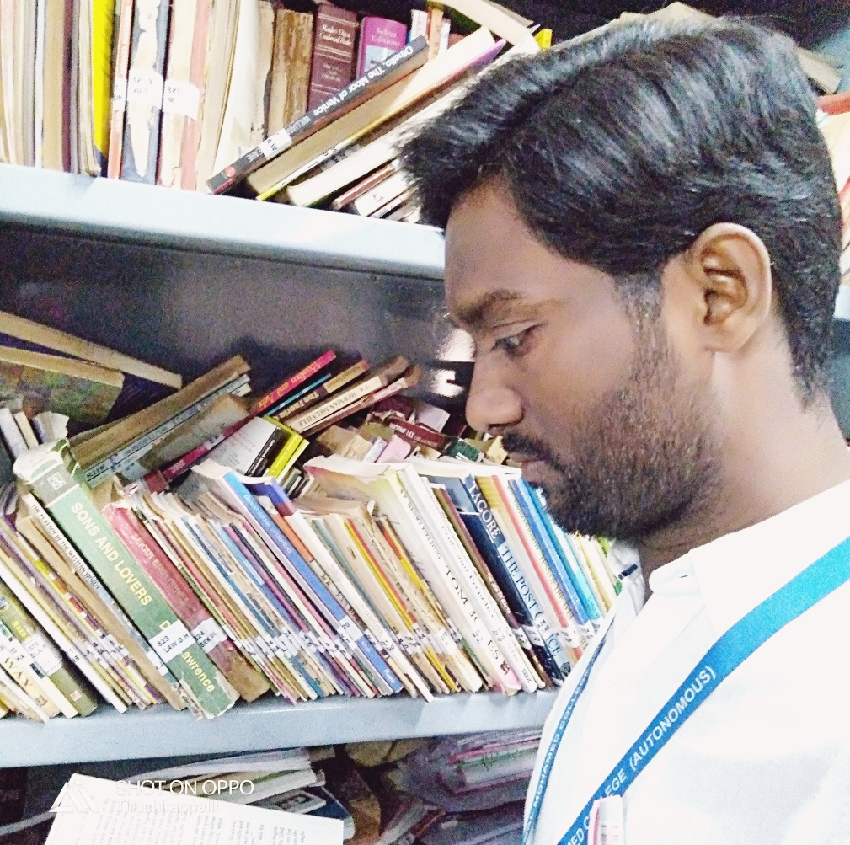
Introduction Of John Keats
Presented by
K.SYED ABTHAHEER M.A.,M.phil.,B.Ed.,PGDCA
Assistant Professor of English
Jamal Mohamed College(Autonomous),
Trichy-20.
syedabutrichy@gmail.com
9042680796

Slide 2
John Keats
John Keats, (born October 31, 1795, London, England—died February 23, 1821, Rome, Papal States [Italy]),
He was an English poet of the second generation of Romantic poets, with Lord Byron and Percy Bysshe Shelley.
English Romantic lyric poet who devoted his short life to the perfection of a poetry marked by vivid imagery, great sensuous appeal, and an attempt to express a philosophy through classical legend.
His influence can be seen in the poetry of Alfred, Lord Tennyson, and the Pre-Raphaelites, among others.
John Keats died of tuberculosis in Rome in 1821 at the age of 25.

Slide 3
John Keats’s occupation
John Keats was apprenticed to a surgeon in 1811.
He broke off the apprenticeship in 1814 and went to London, where he worked as a dresser, or junior house surgeon, at Guy’s and St. Thomas’ hospitals.
His literary interests had crystallized by this time, and after 1817 he devoted himself entirely to poetry.

Slide 4
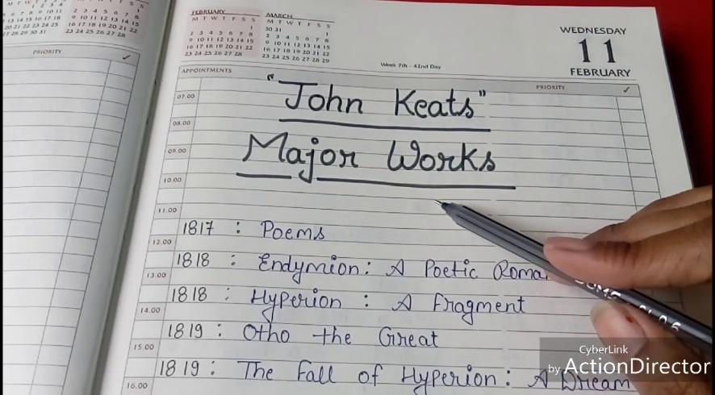
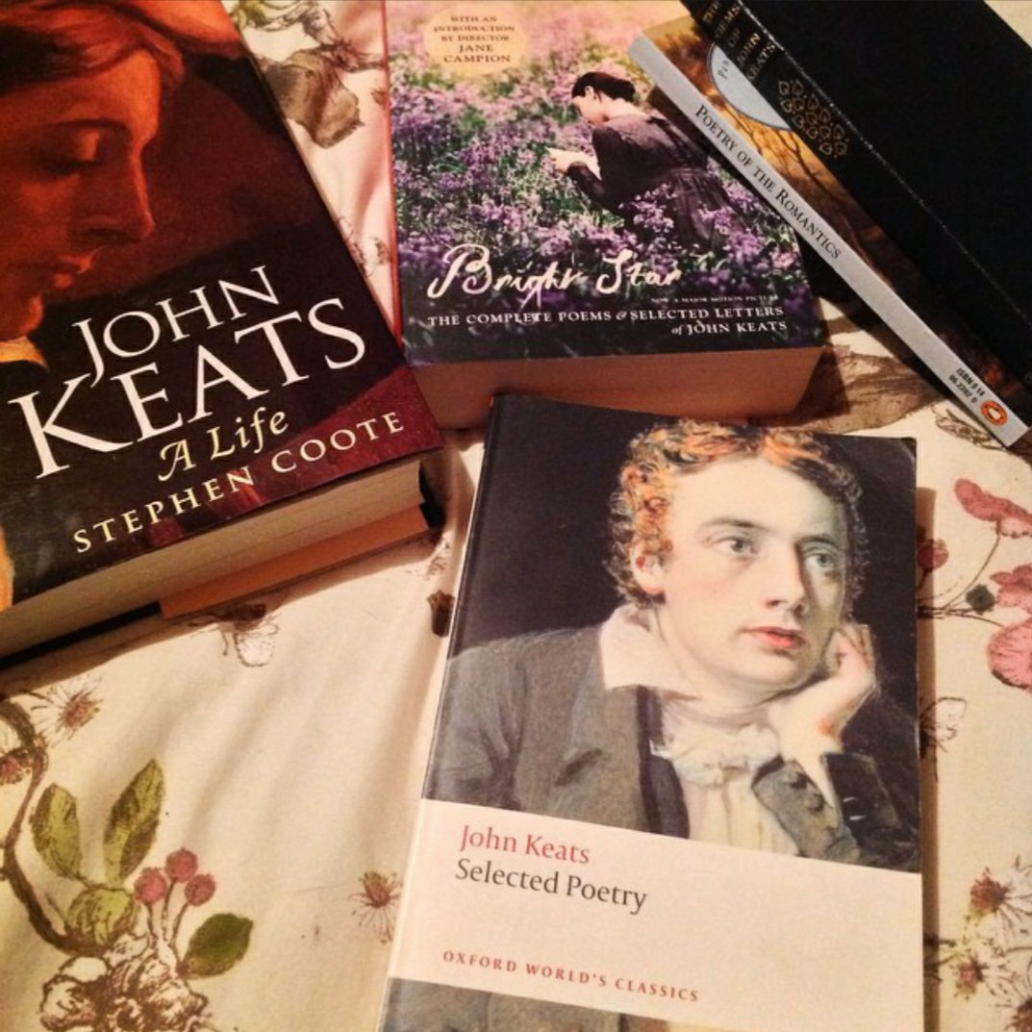
Notable Works
“endymion”
“hyperion”
“Isabella”
“la bella dame sans merci”
“lamia”
“ode on a Grecian urn”
“ode to a nightingale”
“the eve of st.agnes”
“to autumn” etc…

Slide 5
Themes in Keats's Major Poems
transient sensation or passion / enduring art.
dream or vision / reality.
joy / melancholy.
the ideal / the real.
mortal / immortal.
life / death.
separation / connection.
being immersed in passion / desiring to escape passion.

Slide 6
Famous quotes
'Beauty is truth, truth beauty'.
'Heard melodies are sweet, but those unheard are sweeter'.
'A thing of beauty is a joy forever'.
'Bright star, would I were steadfast as thou art'.
'Season of mists and mellow fruitfulness'.
'The poetry of Earth is never dead'.
‘I love you the more in that I believe you had liked me for my own sake and for nothing else’.
‘Nothing ever becomes real till it is experienced’.

Slide 7
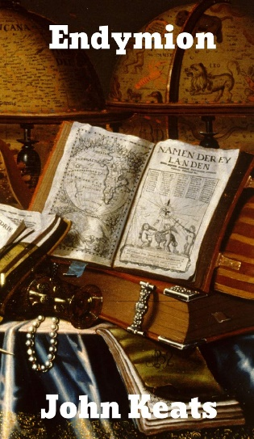

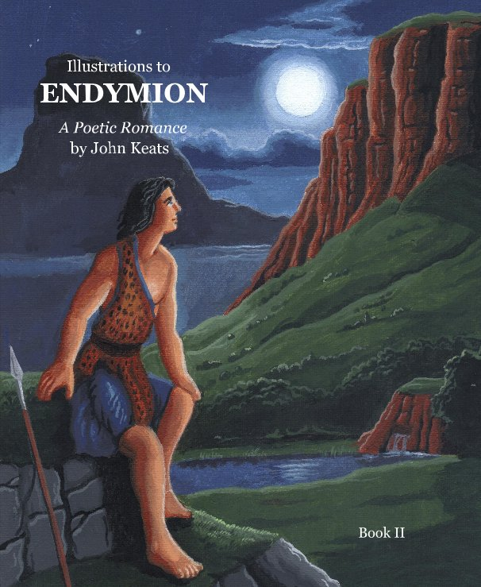
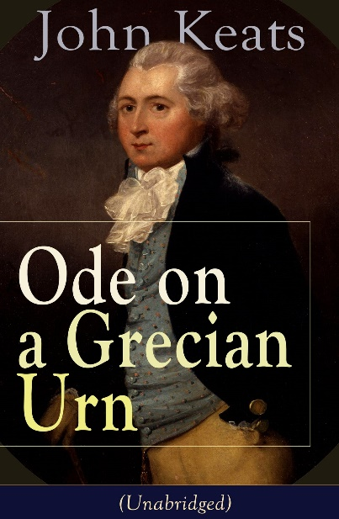
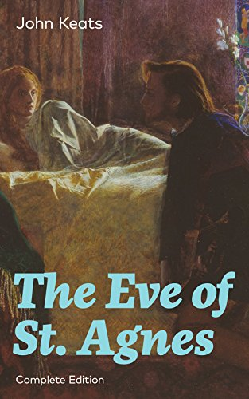

Images
My love is selfish. I cannot breathe without you.-John Keats

Slide 8


Slide 9
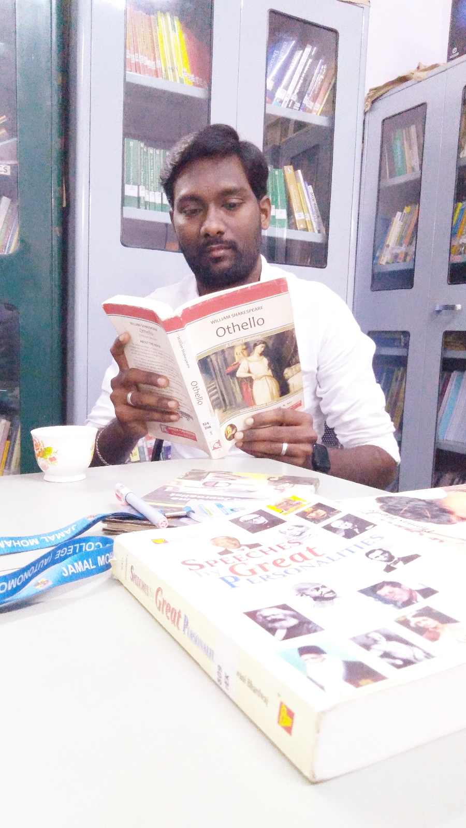
Presented by
K.SYED ABTHAHEER M.A.,M.phil.,B.Ed.,PGDCA
Assistant Professor of English,
Jamal Mohamed College(Autonomous),
Trichy-20.
syedabutrichy@gmail.com
9042680796

